Slide 1
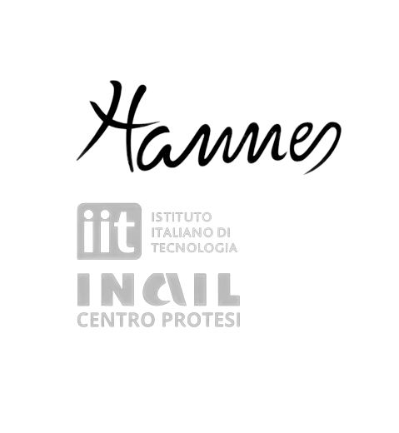
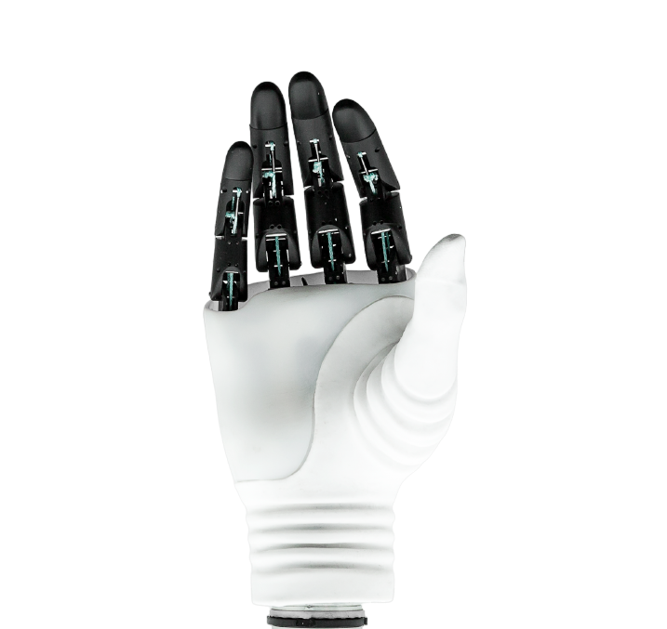

Pisano Davide Ruggero Miriam Anna Terrile Ivan
Notes:
Our topic is HANNES, a hand prosthesis developed by INAIL and the Italian Institute of Technology (IIT) in the field of Rehabilitation Technologies.

Slide 2
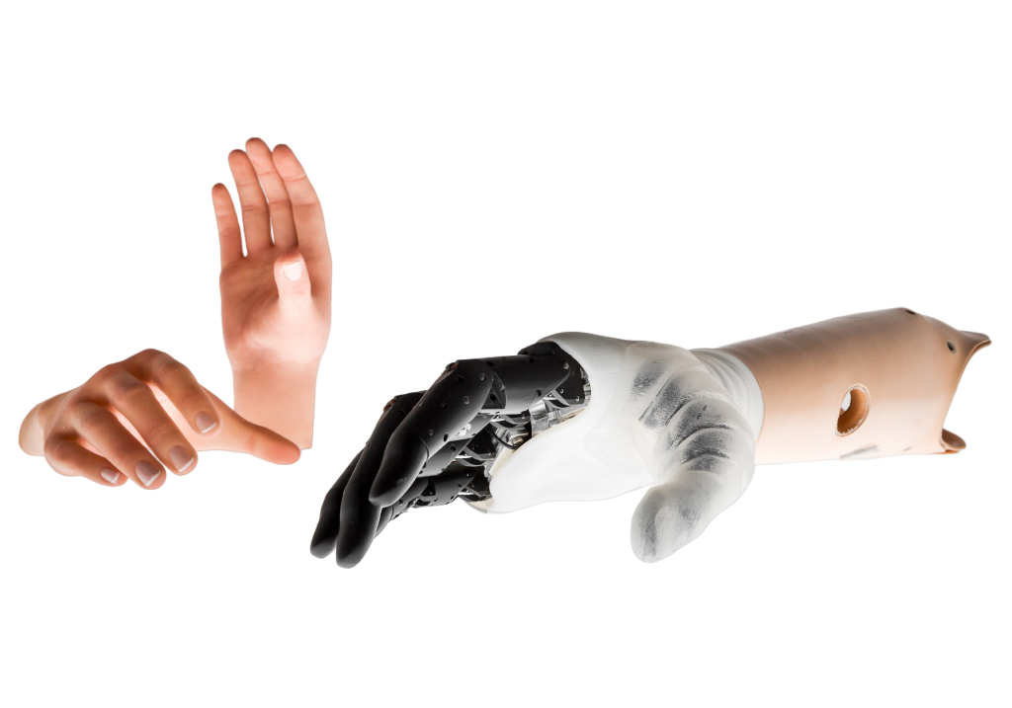
What is Hannes?
It is a sophisticated
under-actuated and
poly-articulated device known for its leader-follower wire configuration that controls finger movements
Notes:
First of all, what is Hannes? Hannes is a poly-articulated and under-actuated prosthesis taht represents a significant advancement in the field, with an innovative design influenced by the pioneer of prosthetic research, Professor Johannes Schmidl.
In the two images, you can see the complete device, consisting of the hand, the socket interface, and silicone gloves to be used as a covering.

Slide 3
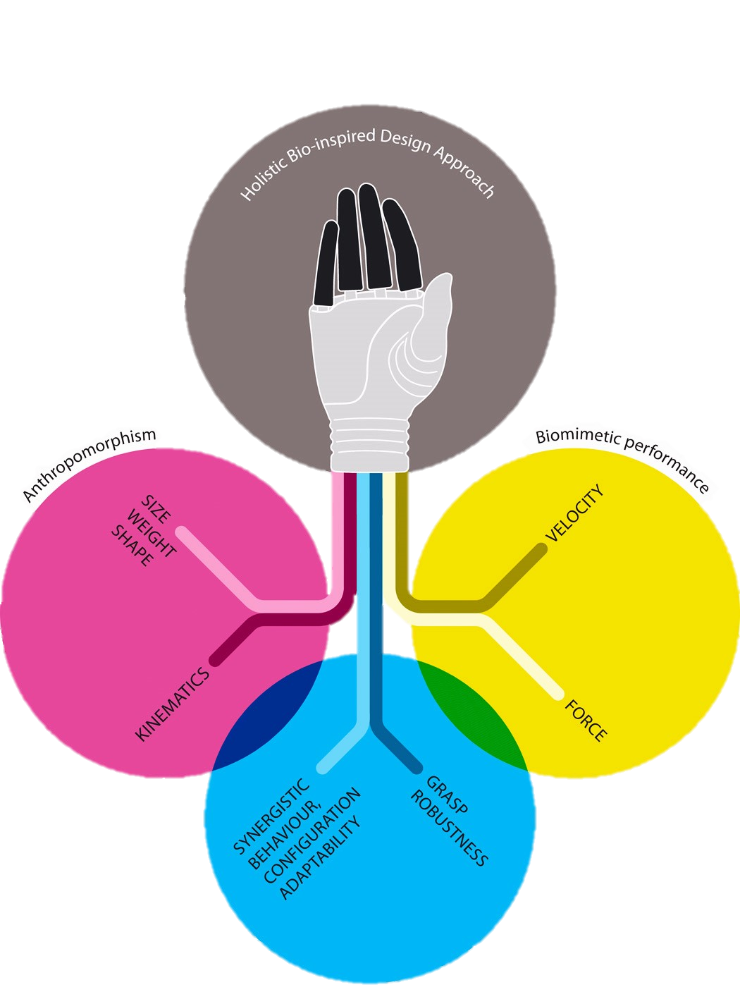
Concepts and Goals
The proposed of this device is simultaneously achieves accurate:
Anthropomorphism
Biomimetic performance
Human-like grasping behavior
Human-like grasping
Notes:
The idea behind HANNES is to create a hand that is as close as possible to a real one in all its defining aspects. The three fundamental aspects are Anthropomorphism, Biomimetic Performance, and Human-Like Grasping Behavior, as illustrated in the graphical diagram.

Slide 4
Concepts and Goals
Anthropomorphism
Hannes, authentically replicate the shape, dimensions, weight, and kinematics of the human hand. Exhibiting exceptional similarity to a human hand
Human-like grasping
Notes:
In the context of prosthesis, anthropomorphism refers to the artificial hand's ability to authentically replicate the shape, dimensions, weight, and kinematics of the human hand. As we will see later, the high fidelity in the reproduction of anthropomorphism in Hannes is demonstrated by directly comparing it’s size, shape, and kinematic model with anthropometric data and the kinematics of a real human hand.

Slide 5
Concepts and Goals
Biomimetic performance
its mechatronic design is such that its performance is very close to that exhibited by a human hand for the execution of ADLs
Human-like grasping
Notes:
In terms of biomimicry, the mechatronics of the hand have been developed and designed in such a way, that its performance closely resembles that of a human hand in carrying out Activities of Daily Living (ADLs). The results, obtained through various experiments, demonstrate that the device surpasses the required velocity and grasping forces levels to perform tasks efficiently and powerfully. This specific characteristic allows a wide range of movements, very similar to natural biological capabilities.
Moreover, this hand have a precise control over speed and force to facilitates delicate or strong movement.

Slide 6
Concepts and Goals
Human-like grasping behavior
the grasping postures of Hannes, demonstrate its ability to reproduce synergistic humanlike grasping
Human-like grasping
Notes:
All the features I just mentioned involve performing coordinated movements that resemble natural human gestures. This feature offers users a broad spectrum of complex and realistic movements, allowing them to grasp objects of various shapes and sizes. The experimental results are crucial proof of Hannes' exceptional biomimetics in synergistically replicating human-like grasping postures.
By prioritizing naturalness and comfort in daily use, HANNES significantly improves the quality of life of its users.

Slide 7
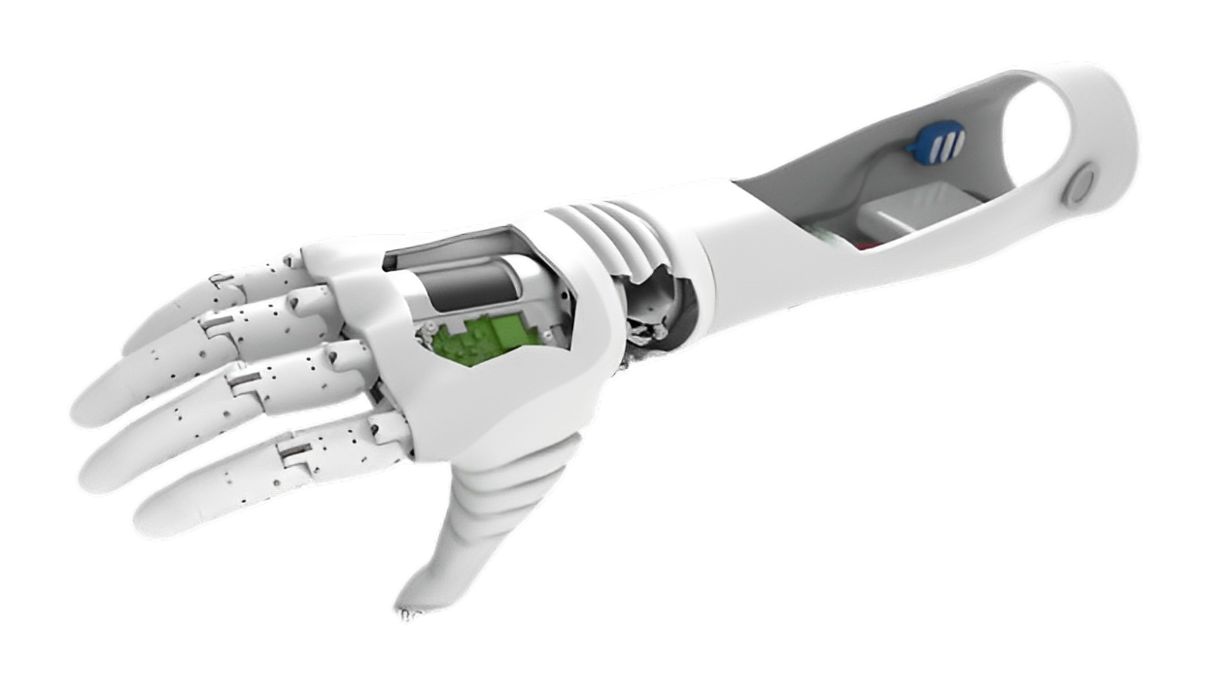
Structure
A rigid prosthetic socket
A poly-articulated myoelectric prosthetic hand
A passive wrist flexion-extension (F/E) module
Notes:
Let's now talk about a more detailed discussion regarding the prosthesis structure. This is composed of three main interacting physical components:
1 - A poly-articulated myoelectric prosthetic hand that utilizes a sub-actuated differential mechanism.
2 - A passive wrist flexion-extension (F/E) module.
3 - A myoelectric interface/controller that includes two surface sensors (EMG), a battery pack, and control electronics.

Slide 8
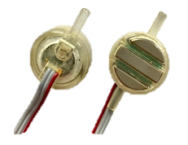
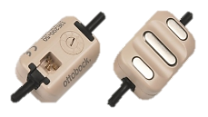
Prosthetic socket
Magnetic plug
connector
sEMG sensors
Battery pack
Emg processing board
and
Battery Management System (BMS)
Notes:
Let's start by describing the last point. As seen in the figure, this is composed by a battery and a management system. The prosthetic hand is powered by internal batteries designed to last up to a day and rechargeable via a magnetic connector located at the end of the prosthesis. Two EMG sensors detect forearm muscle activity and communicate with a customized EMG processing board, sending control signals to the motor board. The EMG board aims to manage the prosthetic device, allowing for opening and closing.

Slide 9
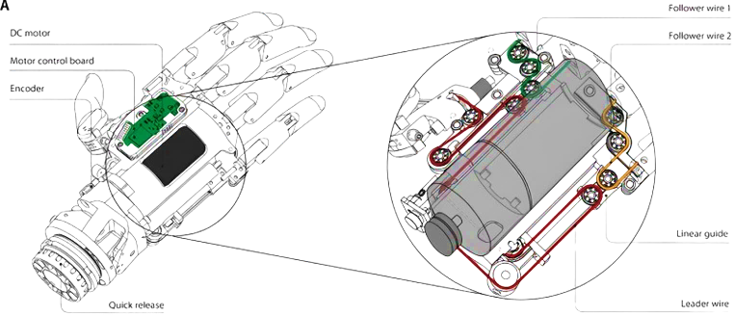
Prosthetic hand
DC Motor
Motor control board
Notes:
The palm of Hannes hosts the main components of the hand: a motor control board and a compact high-power density DC motor. As detailed in the figure, the main cable responsible for the prosthesis movement starts from the motor and reaches the thumb, passing through two different elements mounted on linear guides. In addition of the main wire there are other two cables: the first moves the index and middle fingers, while the second is used to operate the ring and little fingers.

Slide 10
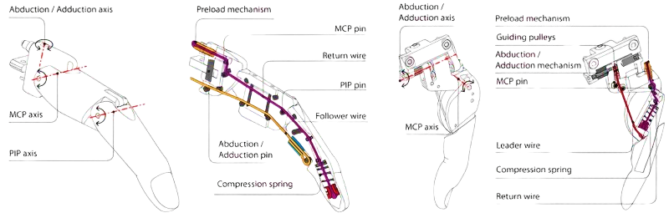
Prosthetic hand
Finger Thumb
DC Motor
Motor control board
Notes:
we can see more in detail how the fingers are composed: Two cables are involved: one for flexing and one for extending the fingers. When the motor acts, the cables either tense or relax, generating movement in the finger joints.
The functioning of the thumb, however, is different:
Through the use of special springs, the thumb can rotate, remain stable, or lock in three different positions to allow for various grips. Additionally, it coordinates with the fingers using a screw to adjust the return force of the movement. This synchronization is important for precise grips, especially when high precision is required.

Slide 11
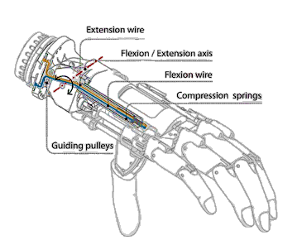
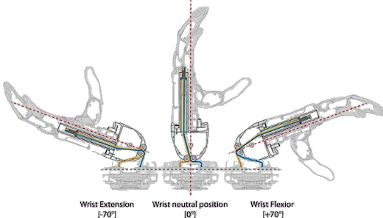
Prosthetic wrist
Flexion Exstention
Wrist (F/E)
Notes:
Lastly, we analyze the intermediate part of the prosthesis. Hannes' wrist F/E module adapts to the natural flexion and extension of the wrist using a spring controlled by cables as can be seen in the figure. During flexion, the spring compresses, during extension the opposite. The function of the spring is to prevent unwanted movements, and a lock allows the wrist to stop in five positions, performing movements within an angle ranging from -70 to +70 degrees. The cables, as in the previous part, are guided by pins and pulleys for stability.

Slide 12
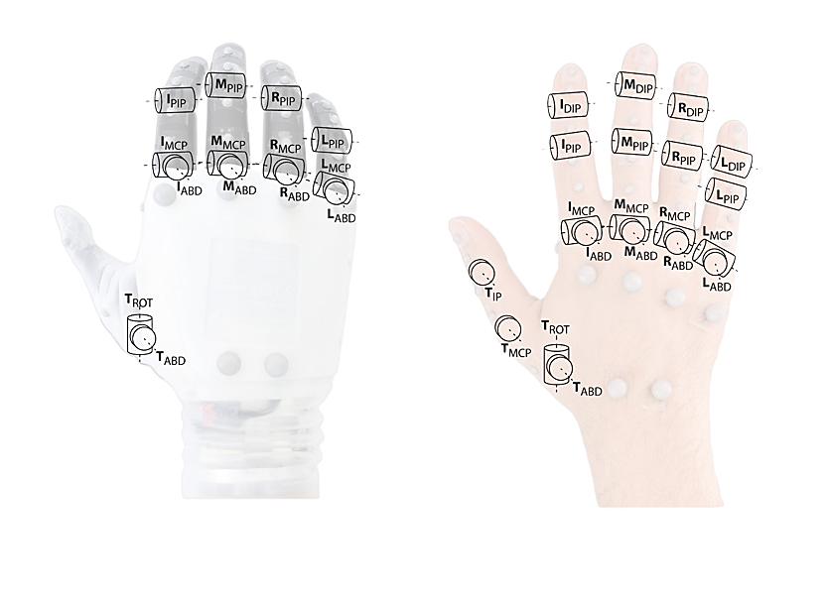
Kinematic Structure
Joint Correlations:
Hannes has fewer joints.
The correlations between the joint angles of Hannes and the human hand during grasping is very high.
Notes:
It's important to note that Hannes, unlike the human hand, has fewer joints. In analyzing the correlations between the joint angles of Hannes and the human hand during grasping, significant correlations were found, particularly between the flexion of Metacarpophalangeal (MCP) joints of adjacent fingers and the adduction of neighboring fingers.

Slide 13
Kinematic Structure
Description of Hannes’s 3 main Synergies:
opening/closure of the hand through MCP flexion of the fingers, involving the thumb .
flexion/extension of Proximal Interphalangeal (PIP) joints of the fingers and thumb adduction.
thumb rotation and adduction.
Notes:
Synergy refers to the coordinated collaboration of elements that produces a combined effect. In the analysis of Hannes’ joints we can describe 3 main synergies:
The opening/closure of the hand through MCP flexion of the fingers, involving the thumb .
The flexion/extension of (PIP) joints of the fingers and thumb adduction.
The thumb rotation and adduction

Slide 14

Standard Control Strategies
Dual-site muscle exploitation, identifying two loci on the stump to recognize opposing movements.
Targeted Muscle Reinnervation (TMR) is an innovative control strategy involving a surgical nerve transfer procedure.
Notes:
Synergy refers to the coordinated collaboration of elements that produces a combined effect. In the analysis of Hannes’ joints we can describe 3 main synergies:
The opening/closure of the hand through MCP flexion of the fingers, involving the thumb .
The flexion/extension of (PIP) joints of the fingers and thumb adduction.
The thumb rotation and adduction

Slide 15
Pattern Recognition Control
Training the
Classifier
INPUT
(sEMG)
Features
Extraction
Trained
Classifier
OUTPUT
(CLASS)
Control through pattern recognition is an advanced approach that leverages artificial intelligence techniques.
Notes:
Synergy refers to the coordinated collaboration of elements that produces a combined effect. In the analysis of Hannes’ joints we can describe 3 main synergies:
The opening/closure of the hand through MCP flexion of the fingers, involving the thumb .
The flexion/extension of (PIP) joints of the fingers and thumb adduction.
The thumb rotation and adduction

Slide 16
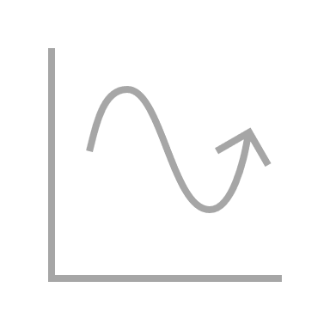
Pattern Recognition Algorithms
The most efficient algorithms :
Linear Discriminant Analysis (LDA).
Non-Linear Logistic Regression (NLR).
Notes:
Synergy refers to the coordinated collaboration of elements that produces a combined effect. In the analysis of Hannes’ joints we can describe 3 main synergies:
The opening/closure of the hand through MCP flexion of the fingers, involving the thumb .
The flexion/extension of (PIP) joints of the fingers and thumb adduction.
The thumb rotation and adduction

Slide 17
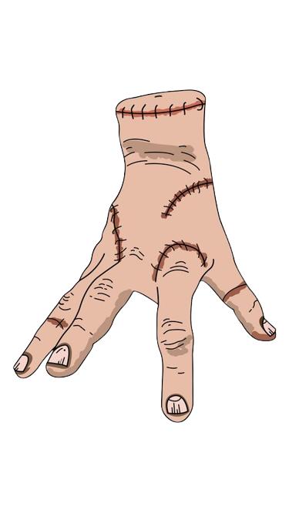
Thanks for the attention

